Slide 1

Healthy Employees, Healthier Municipalities
Notes:
Cover slide. Welcome guests and begin when ready.

Slide 2
WHAT IS BMED WELLNESS?
The goal of the BMED Wellness Program is to support municipalities in creating sustainable employee wellness initiatives that encourage preventive care, healthy lifestyles, and overall employee well-being.
OUR 2027 GOALS
1
DESIGNATE
a Wellness Ambassador
2
LAUNCH OR CONTINUE
your BMED Employee Wellness Program
3
APPLY
for a BMED Wellness Grant
Ambassador • Program • Grant
BMED Wellness 2027 • Healthy Employees, Healthier Municipalities 2
Notes:
Before we talk about the details, I want to start with what BMED Wellness is. The goal of the BMED Wellness Program is to support municipalities in creating sustainable employee wellness initiatives that encourage preventive care, healthy lifestyles, and overall employee well-being. For 2027, I want us focused on three actions: designate a Wellness Ambassador, launch or continue your BMED Employee Wellness Program, and apply for the BMED Wellness Grant.

Slide 3
Why an Ambassador in Every Municipality?
A local champion turns BMED resources into employee participation.
CONNECT
One point of contact between employees, the municipality and BMED.
ENGAGE
Share opportunities, build participation and keep wellness visible.
ORGANIZE
Track completion, coordinate locally and help keep the program moving.
The role is manageable.
Ambassadors are not healthcare providers and do not manage confidential health information. They are the local connector and program champion.
BMED provides the framework. You bring the people.
WHO CAN BE AN AMBASSADOR?
Anyone in your organization who is organized, enthusiastic, approachable and interested in employee wellness.
BMED Wellness 2027 • Healthy Employees, Healthier Municipalities 3
Notes:
A Wellness Ambassador is the connection between BMED and the employees in your municipality. You do not need to be a health professional, and you are not responsible for anyone's confidential health information. Your Ambassador can be anyone in your organization who is organized, enthusiastic, approachable, and genuinely interested in employee wellness. We are looking for someone willing to communicate opportunities, encourage participation, and help keep the local program moving. BMED will support you throughout the process. Ask: How many of our current or potential Wellness Ambassadors are here today? Please raise your hand.

Slide 4
BMED HELPS FUND YOUR WELLNESS PROGRAM
The grant is a major opportunity to turn wellness ideas into real employee programming.
BMED WELLNESS GRANT
UP TO $10,000
Up to 50% of eligible program costs
Subject to program requirements and approval
DENTAL-ONLY MEMBERS
UP TO $5,000
BUILD THE PROGRAM
Fitness, education, preventive health, engagement & more
USE BMED SUPPORT
Framework, tools, resources and coordinator assistance
APPLY FOR FUNDING
Turn eligible wellness costs into a reimbursement opportunity
BMED Wellness 2027 • Healthy Employees, Healthier Municipalities 4
Notes:
The grant is one of the biggest benefits of participating. Eligible agencies may receive reimbursement of up to 50 percent of eligible wellness program costs, not to exceed $10,000 annually. Dental-Only member agencies may be eligible for up to $5,000. The funding gives municipalities a real opportunity to create meaningful wellness programming while BMED provides the framework, tools and support.

Slide 5
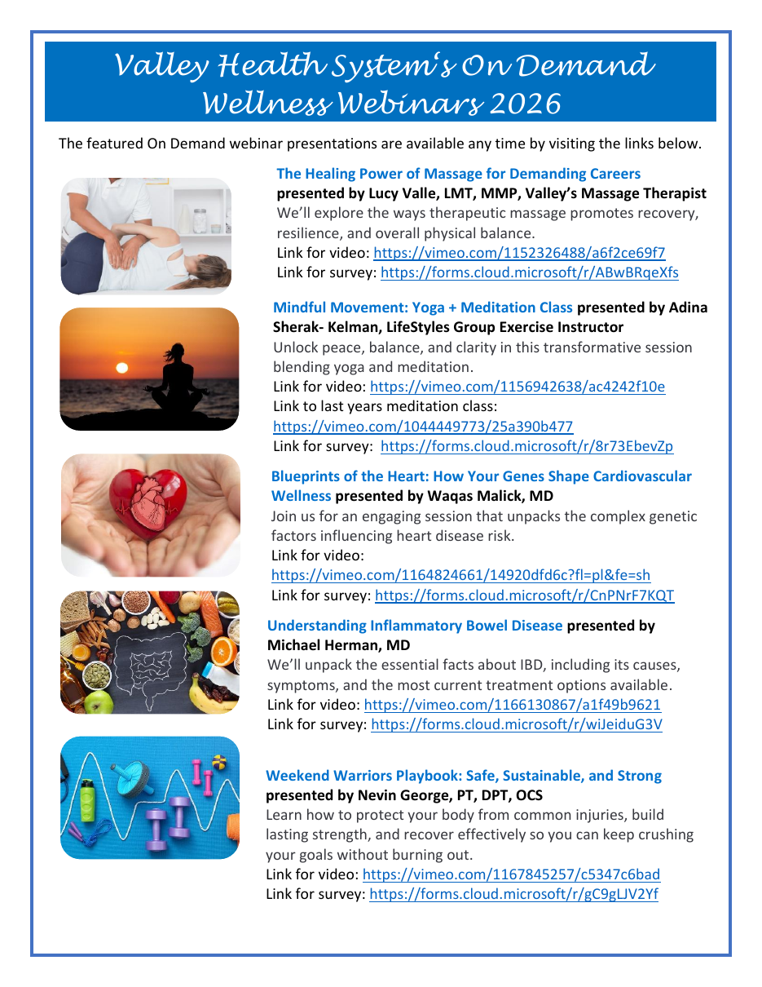
Programming Is Already at Your Fingertips
Valley Health System On-Demand Wellness Webinars
Heart Health
Mental Wellness
Nutrition
Fitness & Strength
Healthy Aging
Preventive Health
Ambassador role:
Share the opportunity → Encourage participation → Track completion
BMED Wellness 2027 • Healthy Employees, Healthier Municipalities 5
Notes:
Valley Health System is a great example of ready-made programming. Their on-demand library covers heart health, mental wellness, nutrition, fitness, healthy aging and preventive health. An Ambassador can share these resources immediately.

Slide 6
One Program. Many Ways to Make It Local.
2027 base requirements keep the framework simple and consistent.
01
02
03
04
05
Annual Physical
Biometric Screening
2 Dental Cleanings
4 Education Programs
1 Additional Activity
The base stays consistent. The local experience can reflect your employees, your departments and your culture.
BMED Wellness 2027 • Healthy Employees, Healthier Municipalities 6
Notes:
The 2027 base requirements are straightforward: physical, biometric screening, two dental cleanings, four educational programs and one additional wellness activity. Municipalities still have flexibility to make the local program their own.

Slide 7
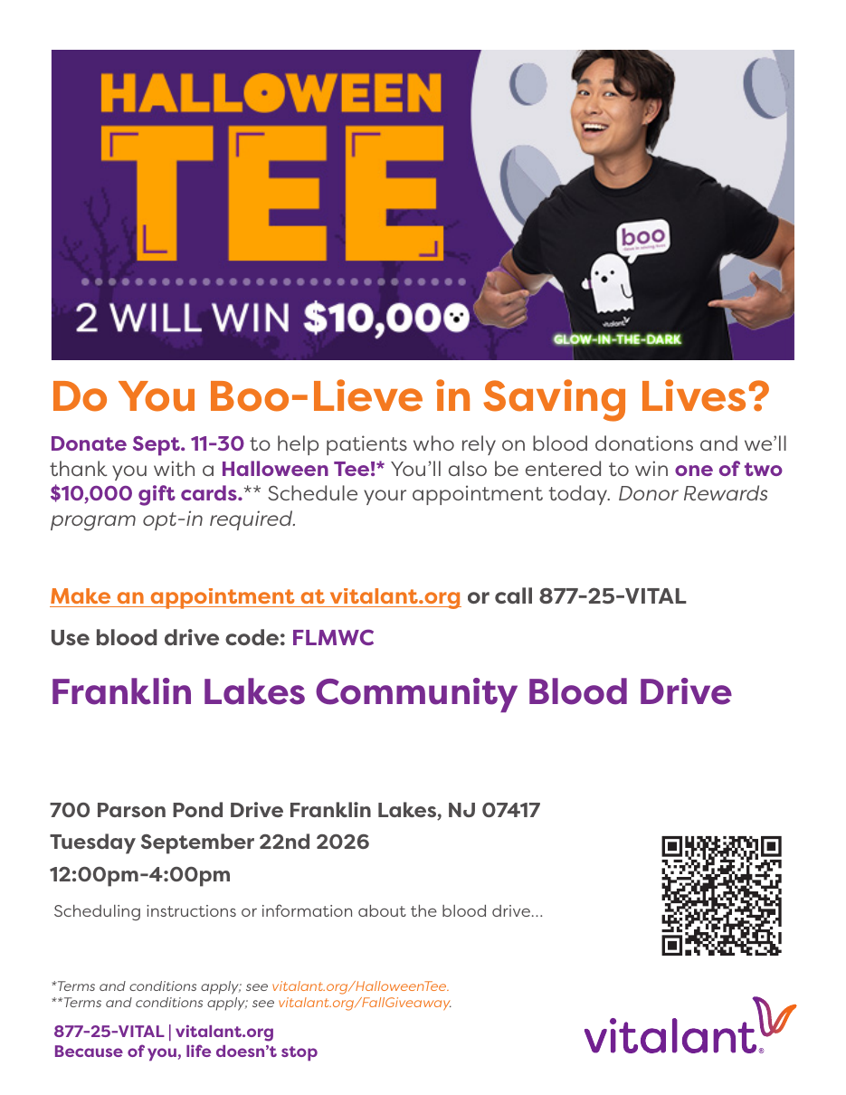
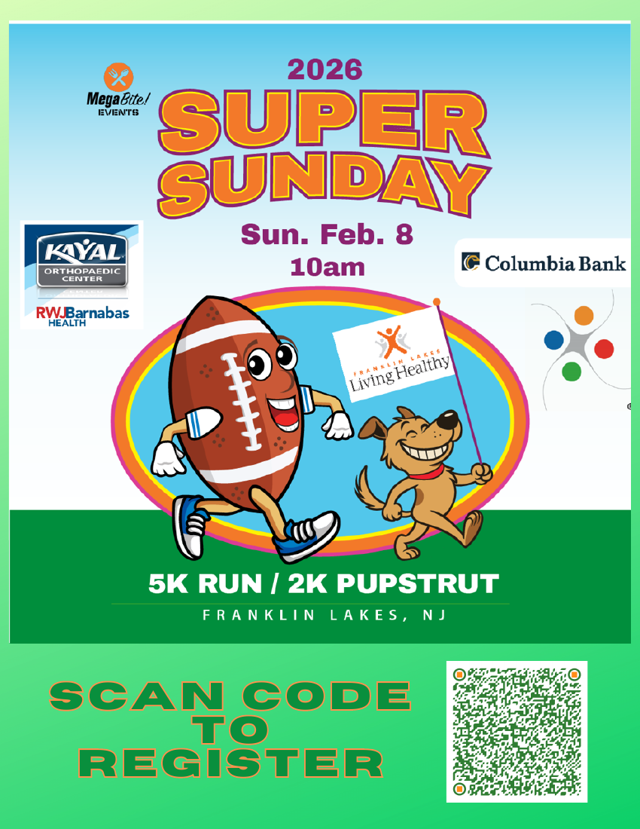
Wellness in Action: Franklin Lakes
Examples can be simple, visible and community-connected.
PREVENTIVE CARE
Blood drives & screenings
MOVEMENT
Walking, fitness & community events
WHOLE-PERSON WELLNESS
Education, engagement & social connection
Take the idea — make it yours.
BMED Wellness 2027 • Healthy Employees, Healthier Municipalities 7
Notes:
Franklin Lakes shows how wellness can connect preventive care, movement, education and community events. These are examples, not a checklist — the point is to borrow ideas that fit your workforce.

Slide 8
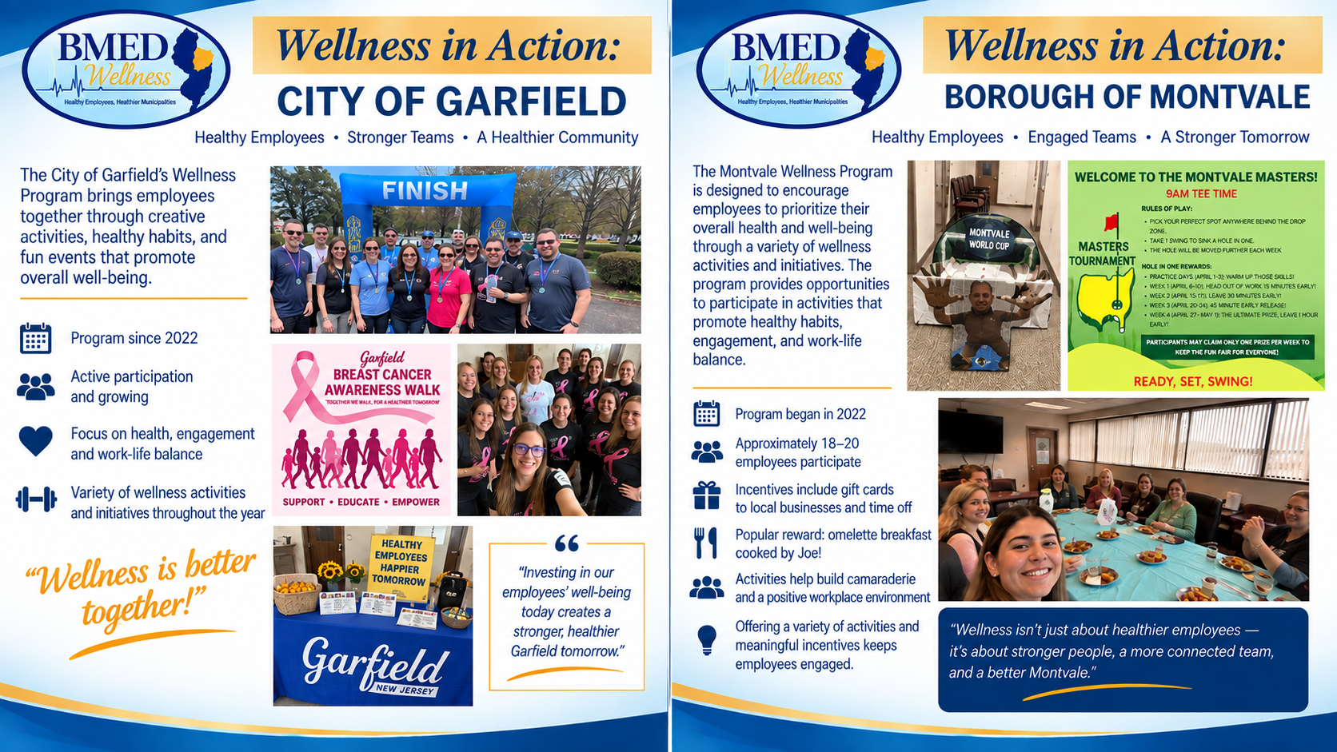
Different ideas. Different incentives. The same goal: healthier, more engaged employees.
BMED Wellness 2027 • Healthy Employees, Healthier Municipalities 8
Notes:
Garfield makes wellness approachable through yoga and beginner-friendly fitness. Montvale began its program in 2022 and has about 18 to 20 employees participating. They use gift cards, extra time off, and even an omelette breakfast as rewards. Their program promotes healthy habits, engagement, work-life balance and camaraderie. Their lesson learned is that variety and meaningful incentives help keep employees interested.

Slide 9
The BMED Wellness Network Is Growing
Current programs are creating momentum — and more municipalities are joining us in 2027.
CURRENT ACTIVE PARTICIPANTS
Franklin Lakes • Oakland • Garfield • Montvale
JOINING / COMMITTED FOR 2027
WESTWOOD
MIDLAND PARK
WOODCLIFF LAKE
EMERSON
Dental Only
LODI
PARK RIDGE
More municipalities. More Ambassadors. A stronger BMED wellness network.
BMED Wellness 2027 • Healthy Employees, Healthier Municipalities 9
Notes:
Our current active BMED Wellness Program participants are Franklin Lakes, Oakland, Garfield, and Montvale. We are excited that the network is already growing for 2027. Westwood, Midland Park, Woodcliff Lake, Emerson as a Dental-Only member, Lodi, and Park Ridge are joining or committed for 2027. More municipalities and more Ambassadors mean more ideas and resources we can share across the Fund.

Slide 10
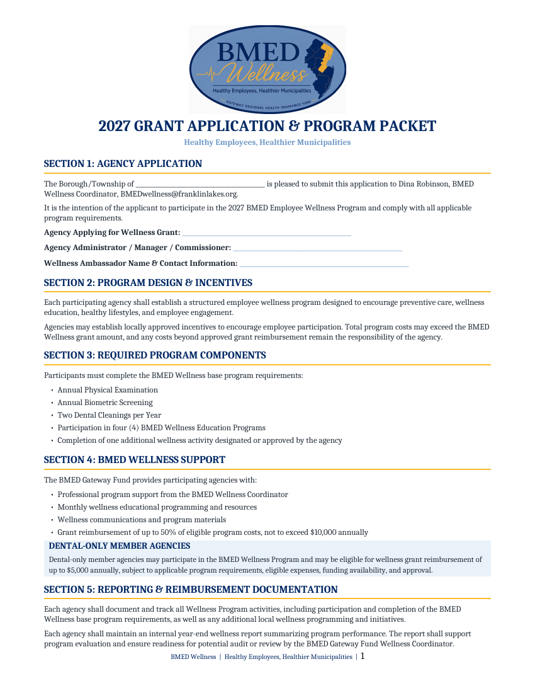
Your 2027 Toolkit Is Ready
The forms, guidance and tracking pieces are already built.
Grant Application & Program Packet
Wellness Tracking Form
Sample Governing Body Resolution
FAQ Sheet
Packet Guide
Wellness Ambassador Guide
You are not starting from a blank page.
BMED Wellness 2027 • Healthy Employees, Healthier Municipalities 10
Notes:
We have also built the 2027 toolkit: application packet, tracking form, resolution, FAQ, guide and Ambassador information. The administrative pieces are ready to use.

Slide 11
READY FOR 2027?
Three actions can move your municipality forward.
1
CHOOSE
your Wellness Ambassador
2
LAUNCH OR CONTINUE
your BMED Employee Wellness Program
3
APPLY
for your BMED Wellness Grant
INTERESTED IN SERVING AS YOUR MUNICIPALITY'S AMBASSADOR?
See Dina today or email BMEDwellness@franklinlakes.org — she will help with the next steps.
We provide the framework, resources and support. You bring wellness to your employees.
BMED Wellness 2027 • Healthy Employees, Healthier Municipalities 11
Notes:
As we wrap up, remember these three actions: choose your Wellness Ambassador, launch or continue your BMED Employee Wellness Program, and apply for the BMED Wellness Grant. If you are already participating, keep building. If you are new, we will help you get started. If you are interested in serving as your municipality's Ambassador, please see me today or email me after the program. I will help you with the next steps. Choose your Ambassador. Launch or continue your program. Apply for your grant. I am here to help you do all three.

Slide 12
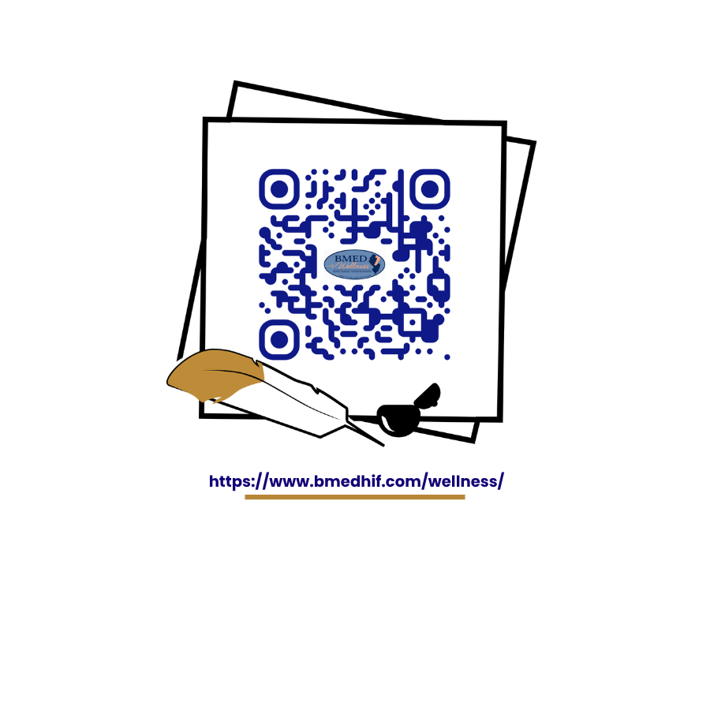
THANK YOU
Questions?
Dina Robinson
BMED Wellness Coordinator
BMEDwellness@franklinlakes.org
Visit the BMED Wellness Page
www.bmedhif.com/wellness/
Healthy Employees, Healthier Municipalities
BMED Wellness 2027 • Healthy Employees, Healthier Municipalities 12
Notes:
Thank you for taking the time to learn more about BMED Wellness and for helping us grow this program. We are also excited to share that we now have a dedicated Wellness Page on the Gateway BMED Fund website. This will be a central place for our municipalities and Wellness Ambassadors to access program information, forms, resources, and updates. You can visit www.bmedhif.com/wellness/. Please reach out to me anytime with questions, ideas, or when you are ready to participate. My contact information is on the screen. At this point, I would be happy to answer any questions.

